Slide 1
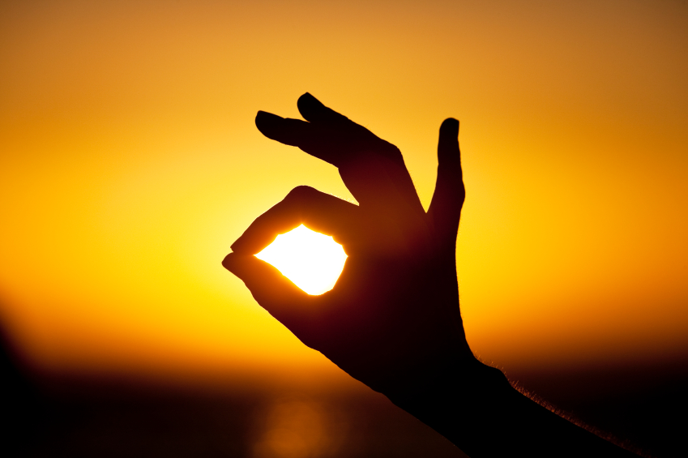


Lumartix SA
131 Rue de l’Ouriette
CH-1170 Aubonne
www.lumartix.com
The power light of tomorrow

Slide 2
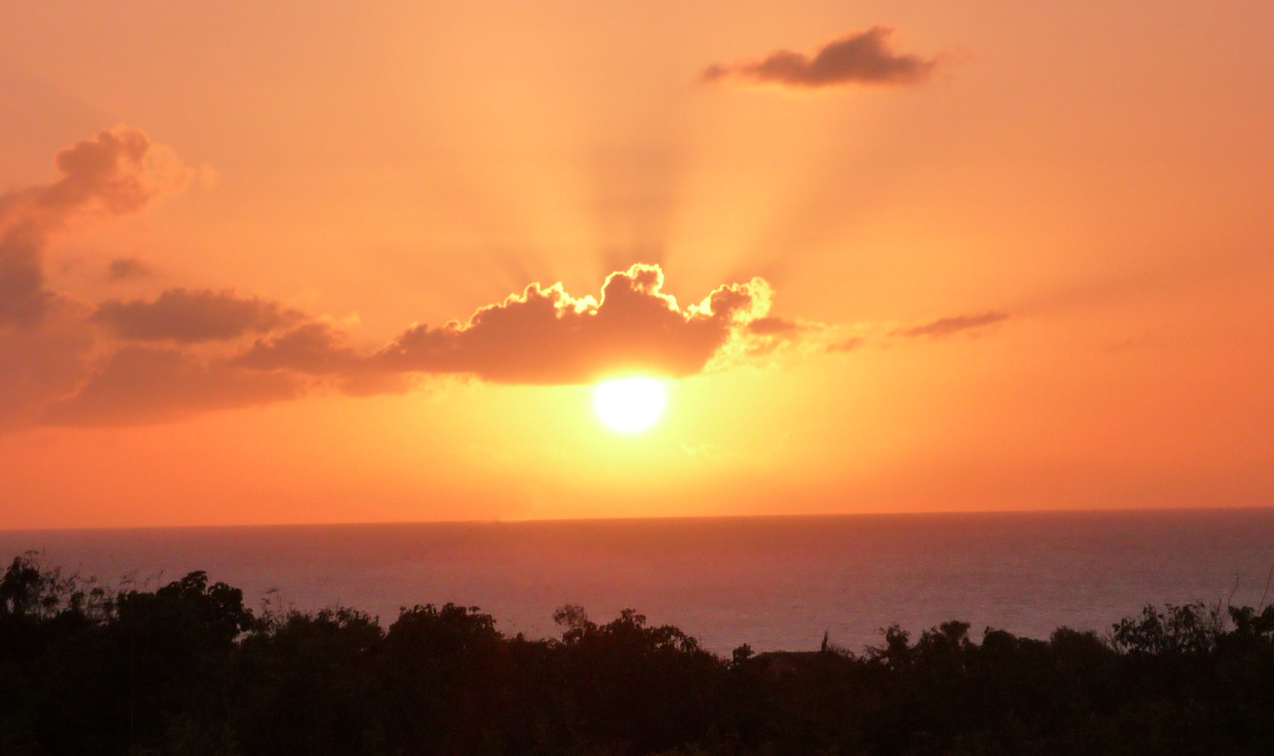
The Sun
@
Your Service
page 2

Slide 3
The companies
Confidential
The group
Solaronix Group
Chemistry (Solaronix)
PV Panel (Solaronix)
Solar Simulators (Lumartix)

Slide 4
The business
Confidential
The activities
Lumartix
Material testing
Agronomy
Movie, TV & Theaters
PV Panels
PV Cells
Seeds selection
Global warming analysis
Projectors

Slide 5
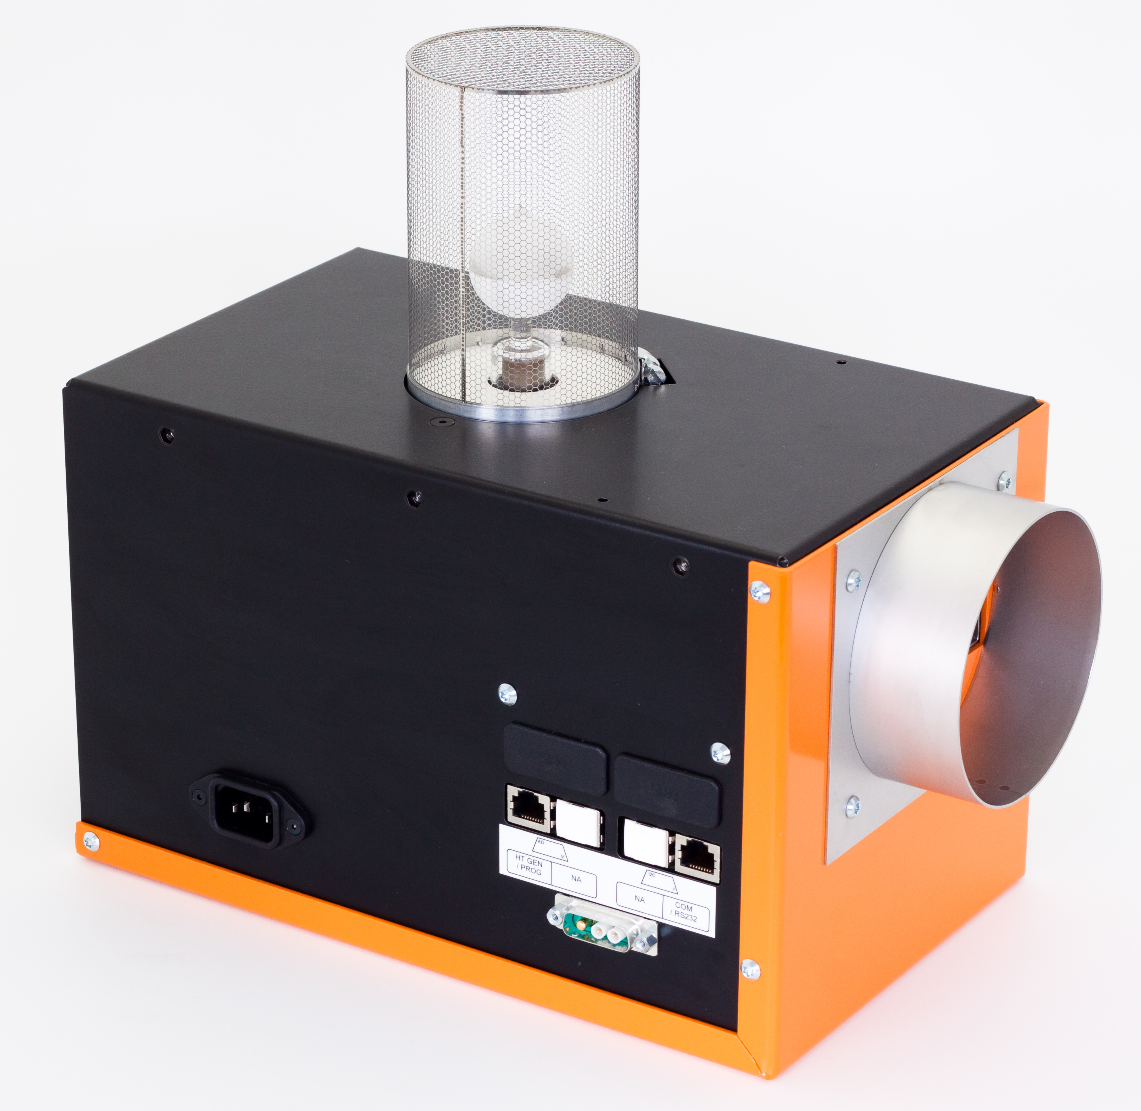
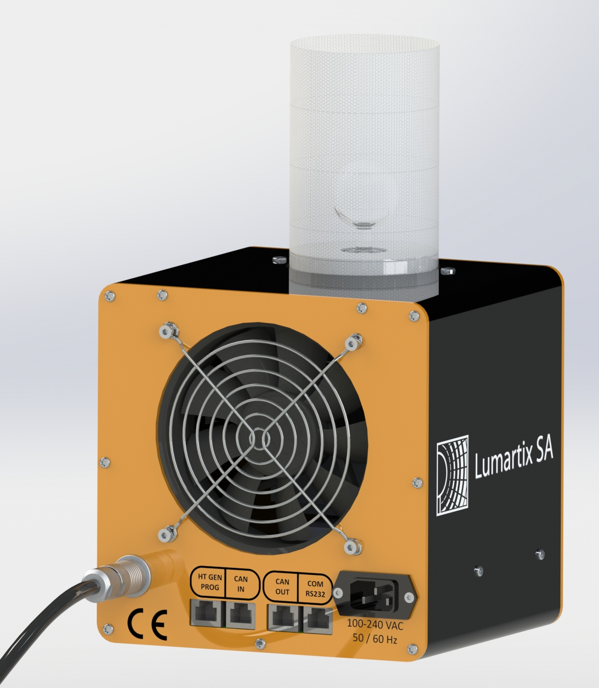
The Plasma Light Engines
Confidential
Lumixo-S
2012
Q1-2016
- Sun spectrum class A according IEC 60904-9
- Life time up to 40’000 hours
- No spectrum shift over time
- No light flux reduction over time

Slide 6
The Plasma Light Engines
Confidential
Lumixo-S
Advantages
- Fast engineering of lamp positioning
- Works in any position
- Linear light flux variation
- Spectrum Class A between 800W and 1300W
- Fast light flux reactivity
- Compatible with “Boost Technology”

Slide 7
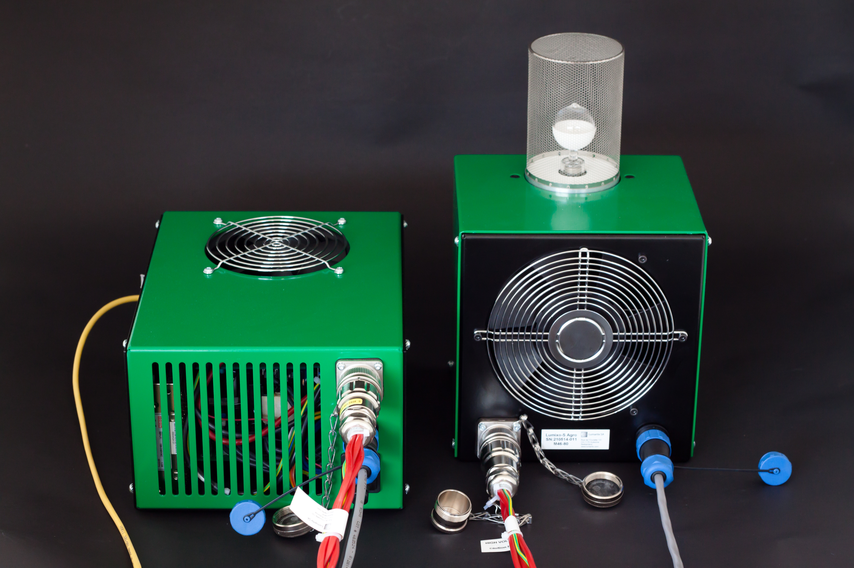
The Plasma Light Engines
Confidential
Lumixo-A
2013
- Sun spectrum class A according IEC60904-9
- Life time up to 40’000 hours
- No spectrum shift over time
- No light flux reduction over time
- IP56

Slide 8
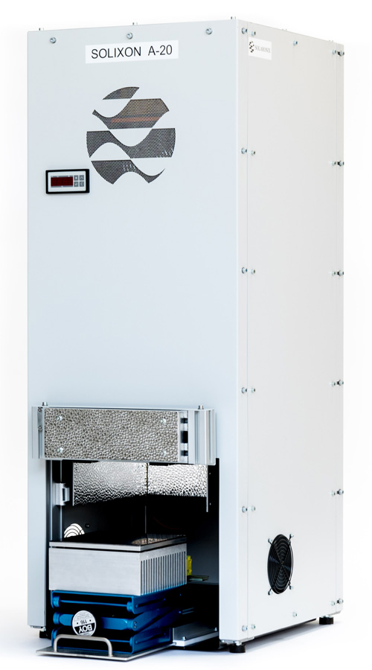
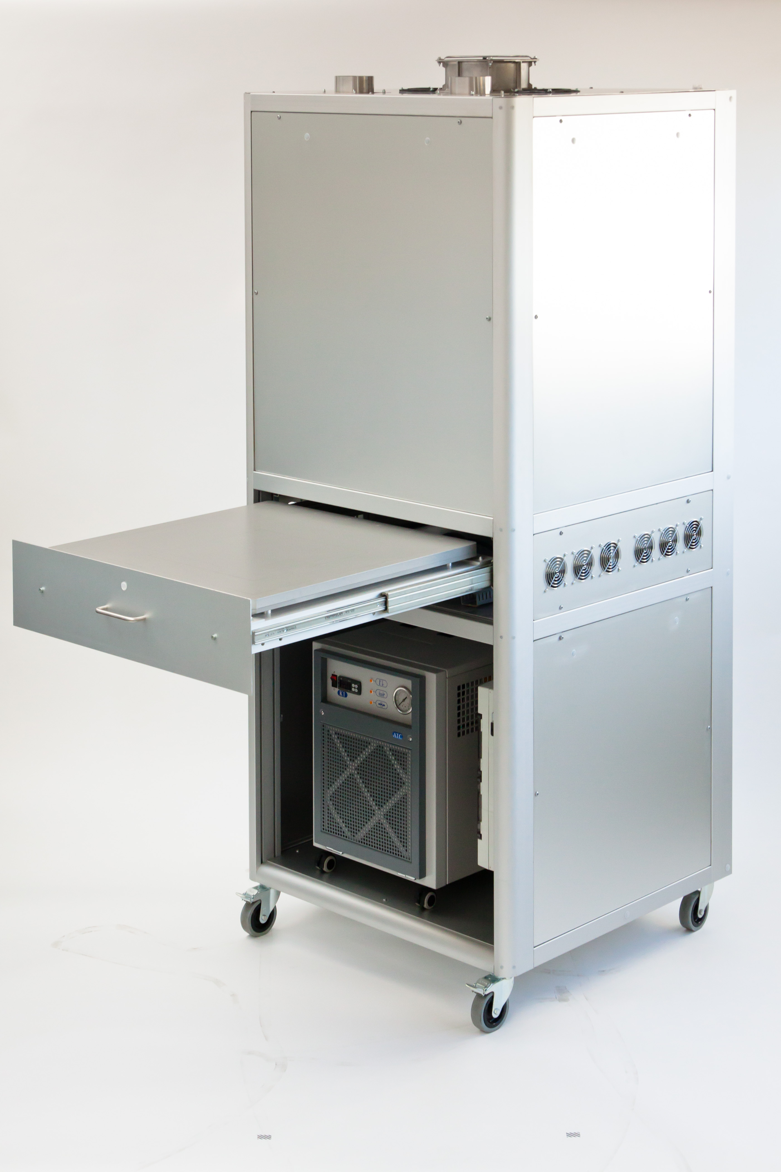
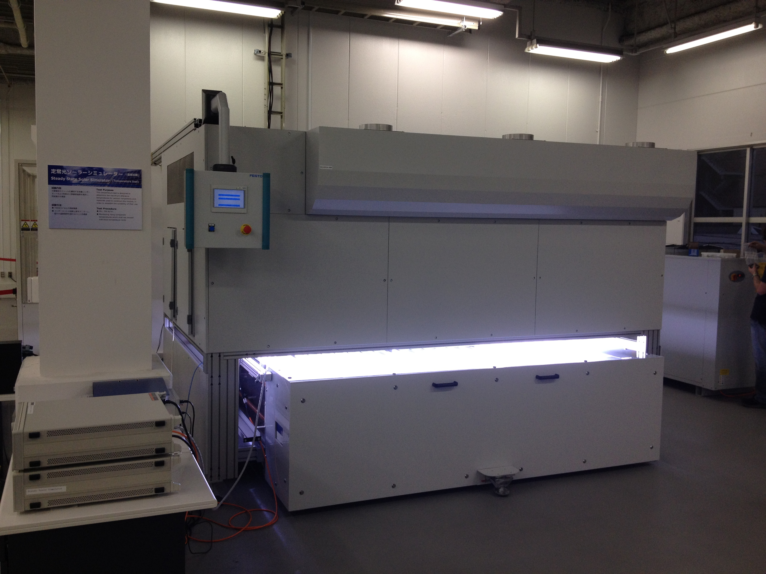
Material testing
Confidential
Solixon Solar Simulators
Class AAA
2.5m x 1.5m
TUV Yokohama
Class A+AA
20cm x 20cm
Class ABA
45cm x 45cm
or
70cm x 70cm

Slide 9
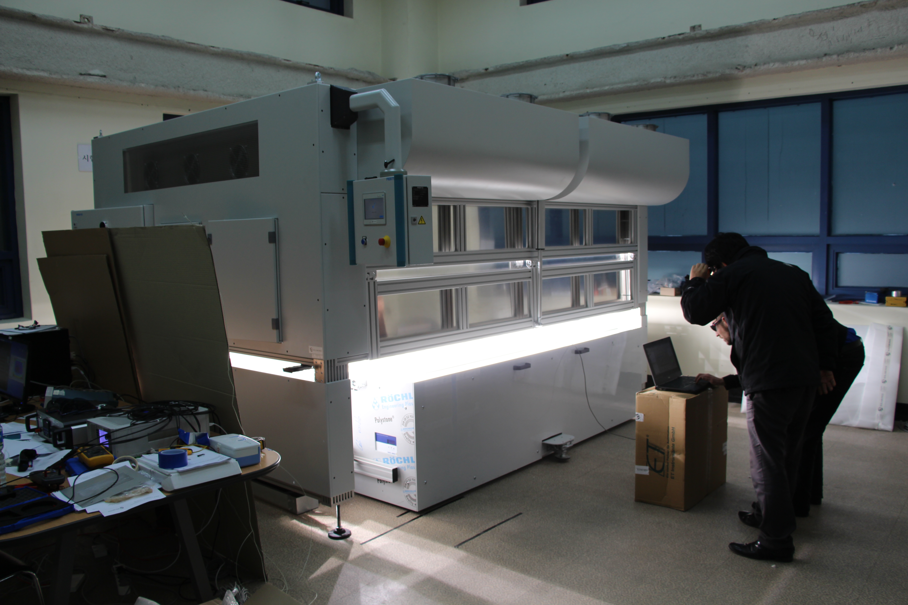
Material testing
Confidential
The Big One
Solixon A-2229
Class AAA
2.2m x 2.9m active surface
Korean Testing Center Seoul
Maximum power determination (MPP)
Measurement of temperature coefficient 25°C to 65°C
Performance at STC and NOCT
Performance at low irradiance (200 W/m²)
Temperature test MST21 under 1000 W/m²
Light soaking
Hot-spot endurance test
Compliant with IEC 60904-9, IEC 61215 & IEC 61646

Slide 10
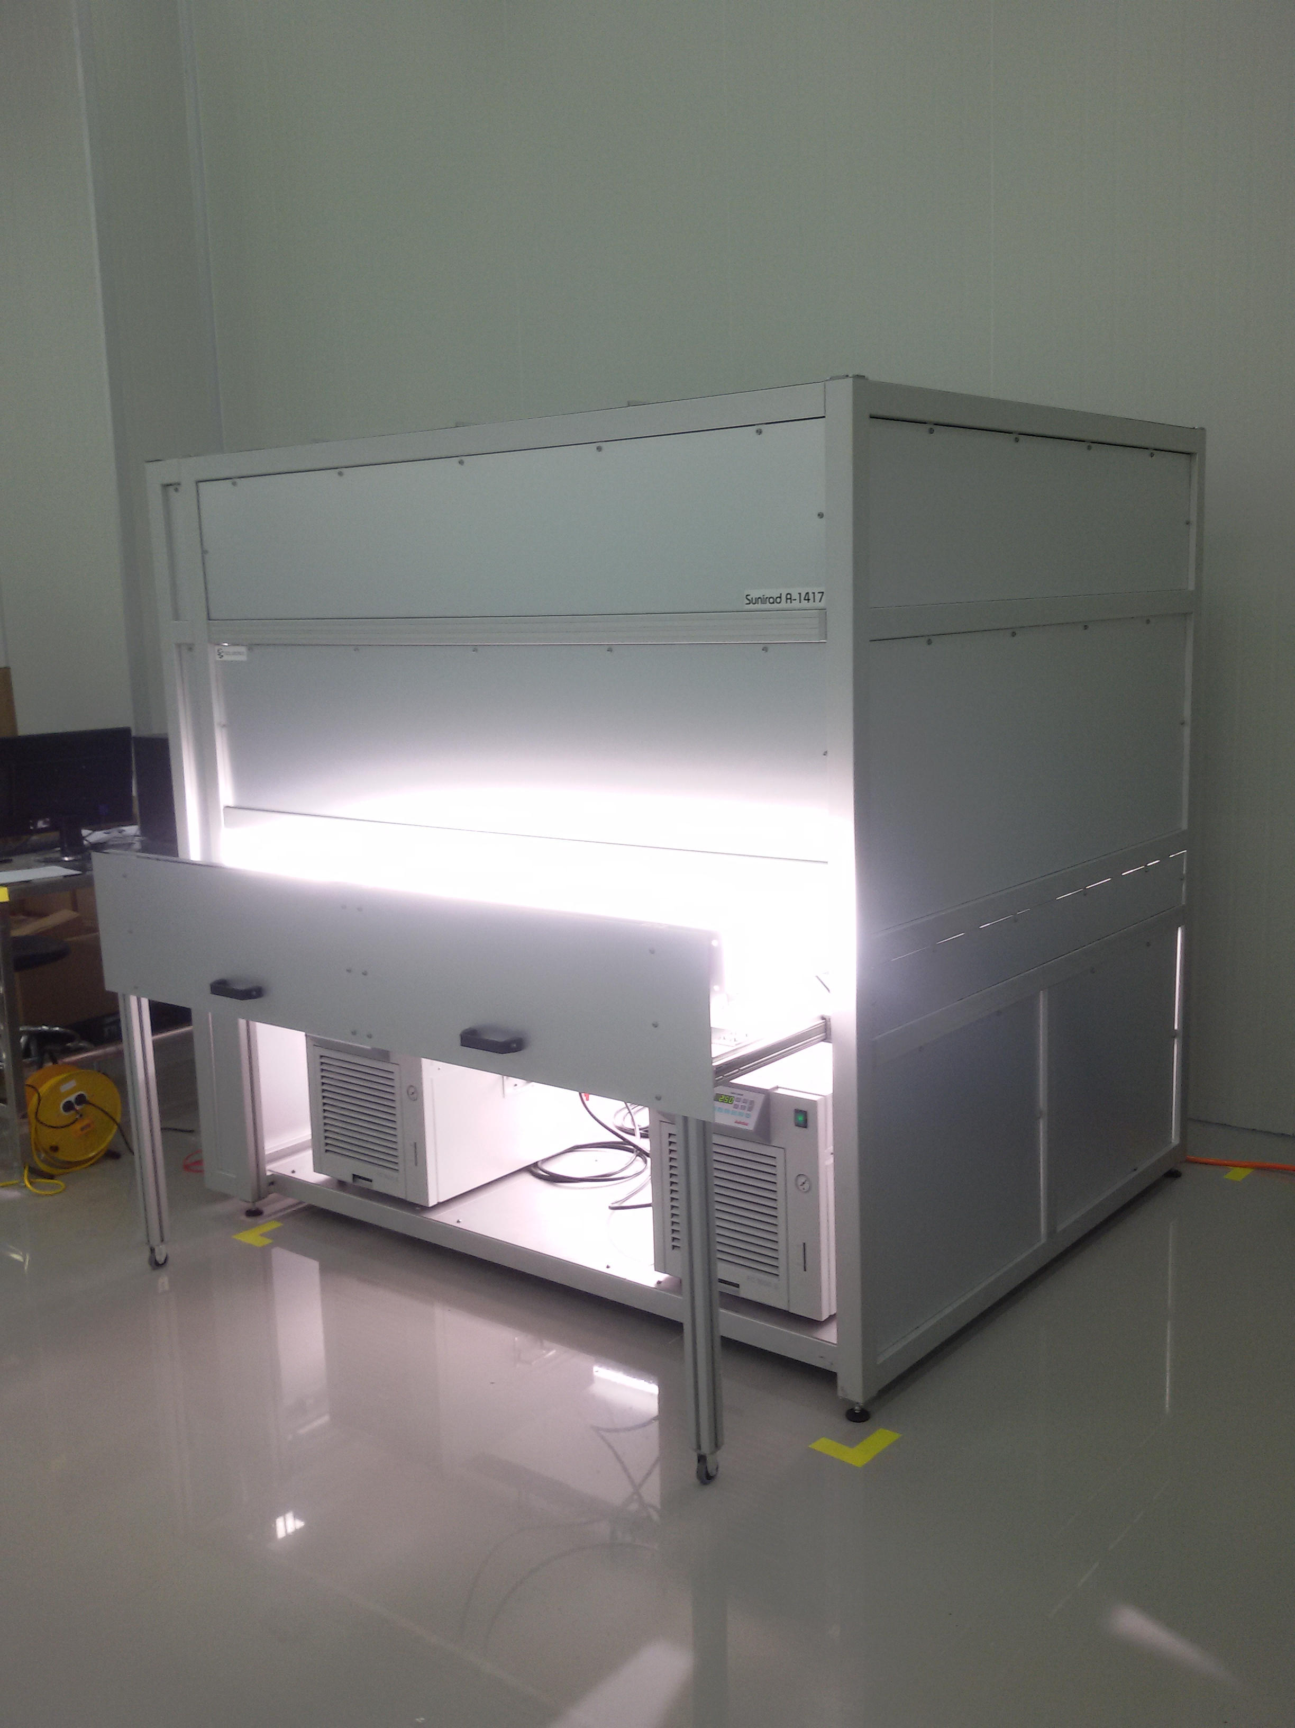
Material testing
Confidential
Light Soaker
Solixon A-1417
Class ABA
1.7m x 1.4m active surface
Capacity of 80 wafers 6’’
Q-Cell Korea, Seoul
Light soaking
Sample holder adjustable between 20°C and 80°C
Compliant with IEC 60904-9, IEC 61215 & IEC 61646

Slide 11
Material testing
Confidential
Light Soaker
Solixon A-1417
Class ABA
1.7m x 1.4m active surface
Capacity of 80 wafers 6’’
Q-Cell Korea, Seoul
Light soaking
Sample holder adjustable between 20°C and 80°C
Compliant with IEC 60904-9, IEC 61215 & IEC 61646

Slide 12
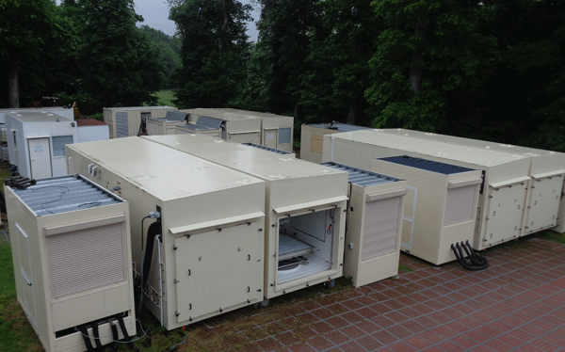
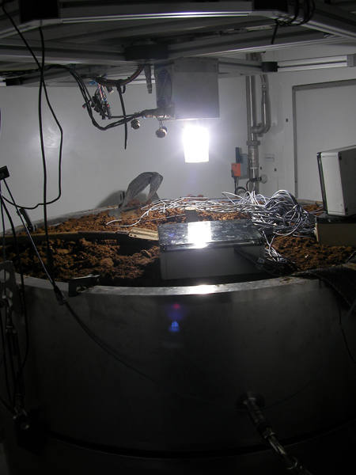
Agronomy
Confidential
Global warming analysis
- Climate chamber
- Temperature control
- Gas control
- Humidity control
- Cesbron & INRA (France, Paris)
- Cooperation with Arizona University

Slide 13
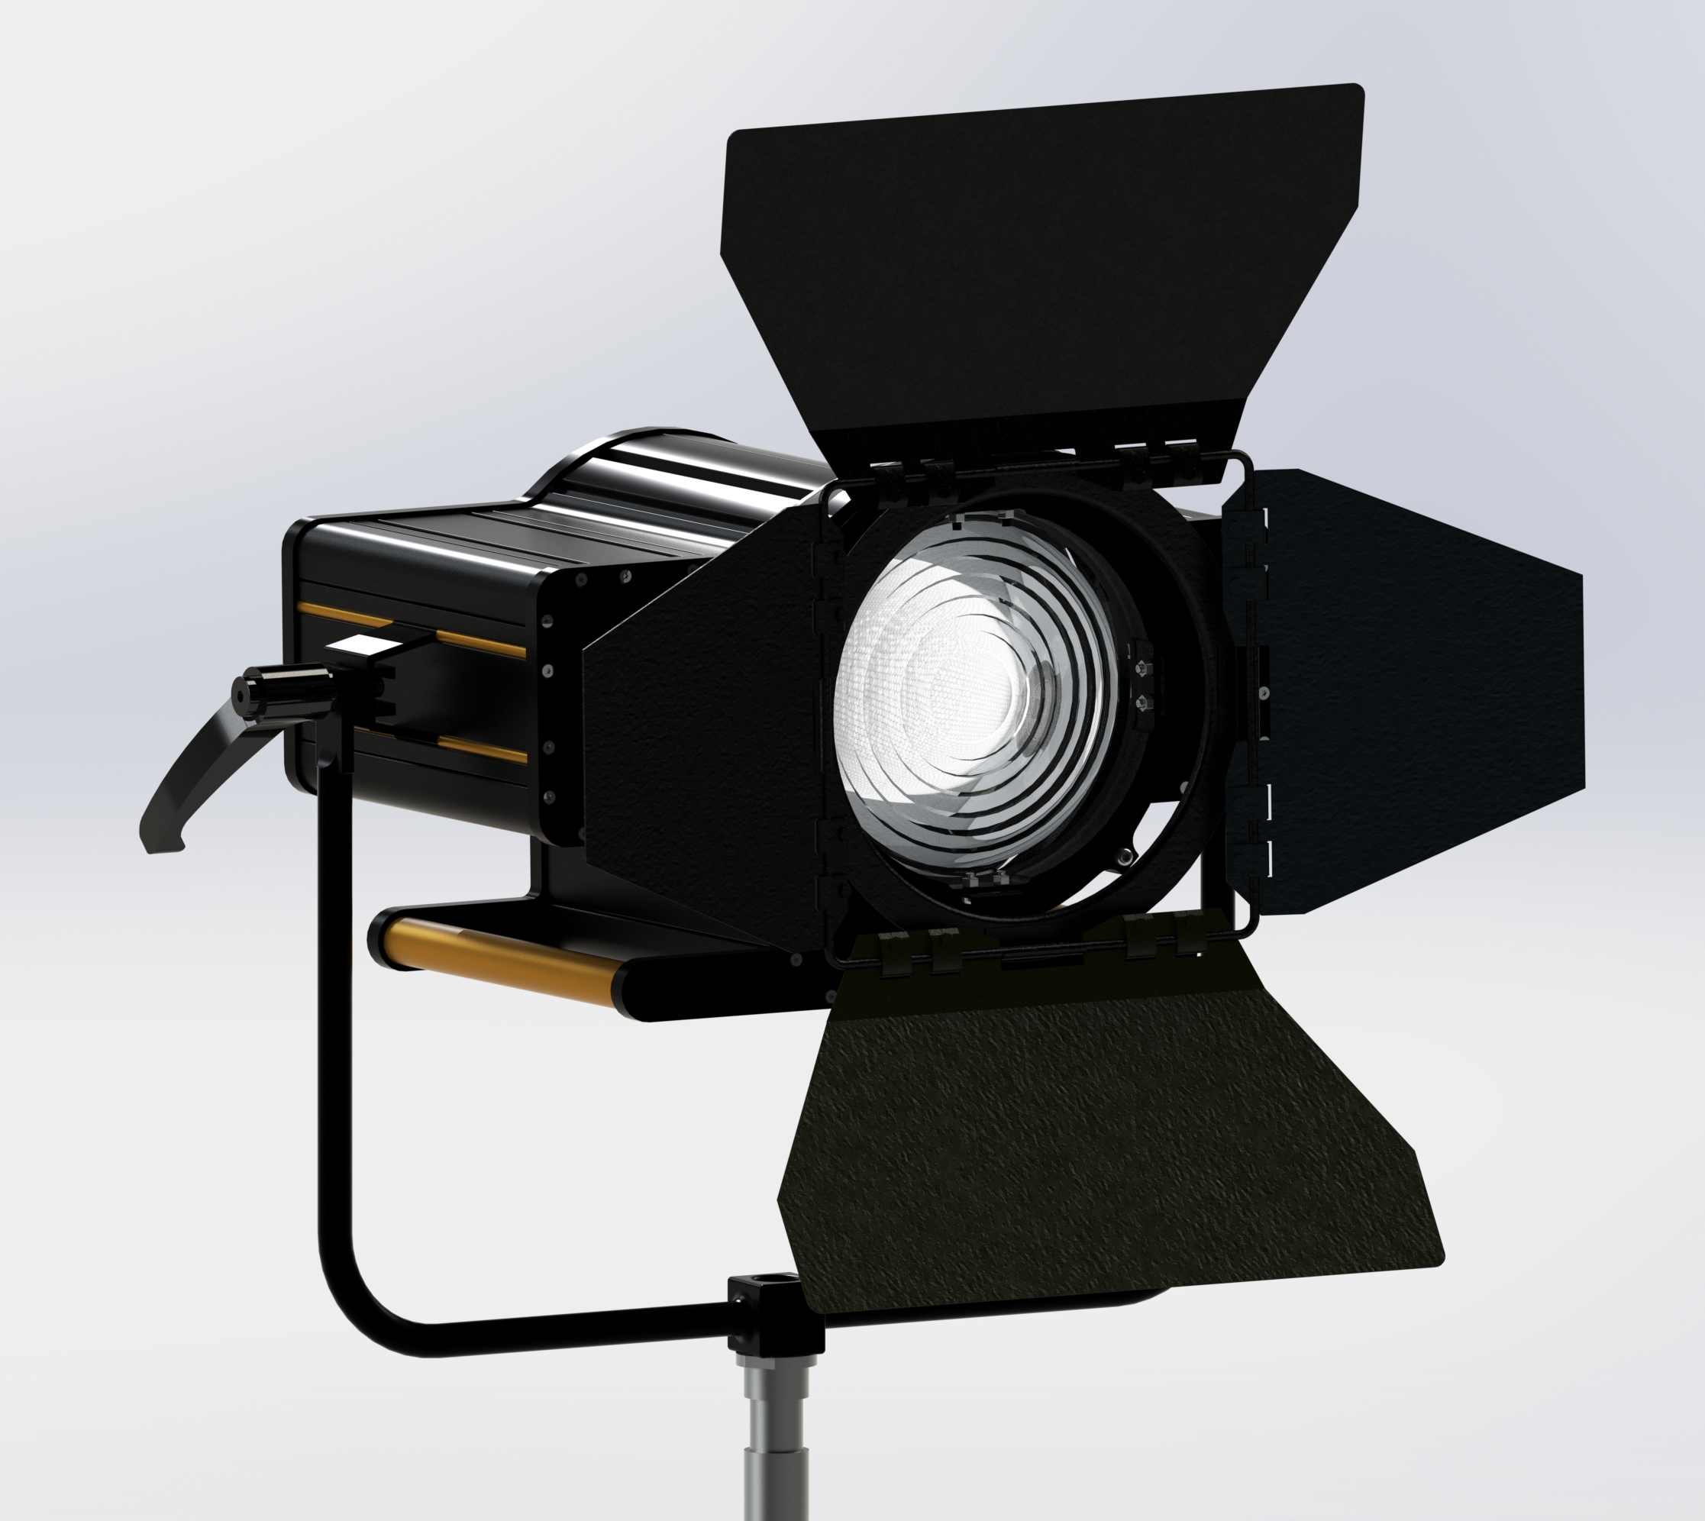
Movie, TV and Theaters
Confidential
Projector PAR
- True Daylight
- Life time up to 40’000 hours
- No spectrum shift over time
- No light flux reduction
- Market introduction Q3-2016

Slide 14
Key customers
Confidential
Customers
PV Cell and PV panel market
  Certification centers
    TUV (Japan, Germany, Korea)
    Korean Testing Center (Korea government)
  Manufacturers
    Hanwha Q-Cell (Korea, Malaysia)
    TP Solar (USA)
    Bosch Solar, Oerlikon Solar, Schott Solar (DE)
    King Design (TW)
Agronomy
  Cesbron, INRA (FR)
  Elmer Production Orchids (CH)
Movie, TV & Theaters
  K5600, Robert-Juliat (FR)
  RTS (CH)

Slide 15


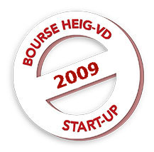

Q&A
Combine our strengths
Thank you for your attention
Lumartix SA
Laurent Calame
laurent@lumartix.com

Slide 16
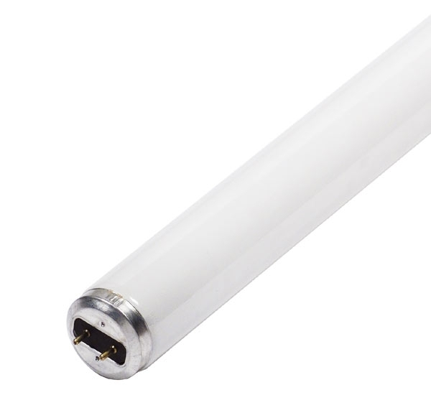
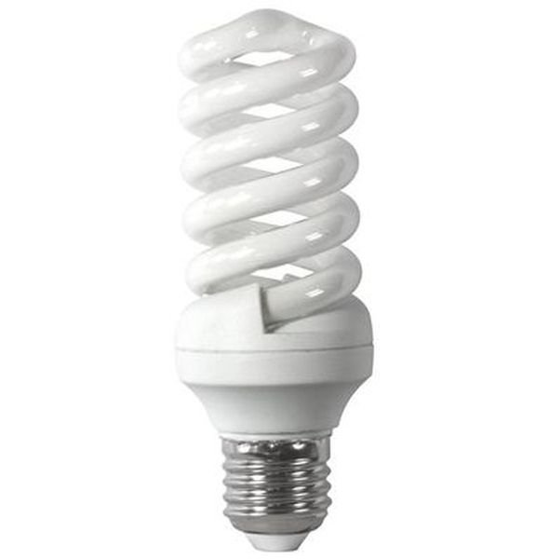
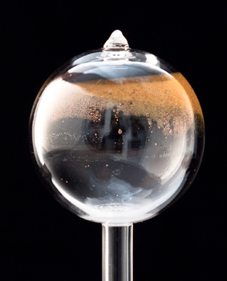
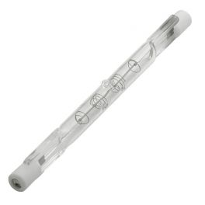
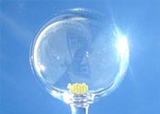
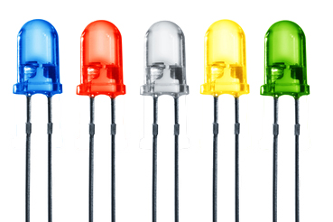
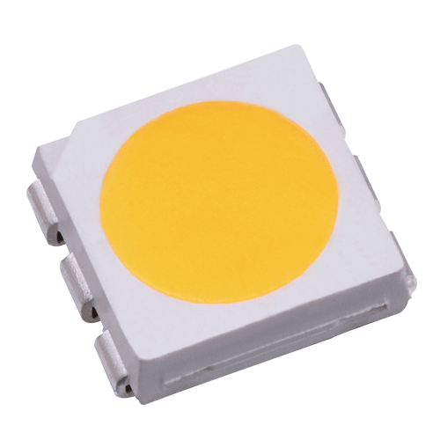
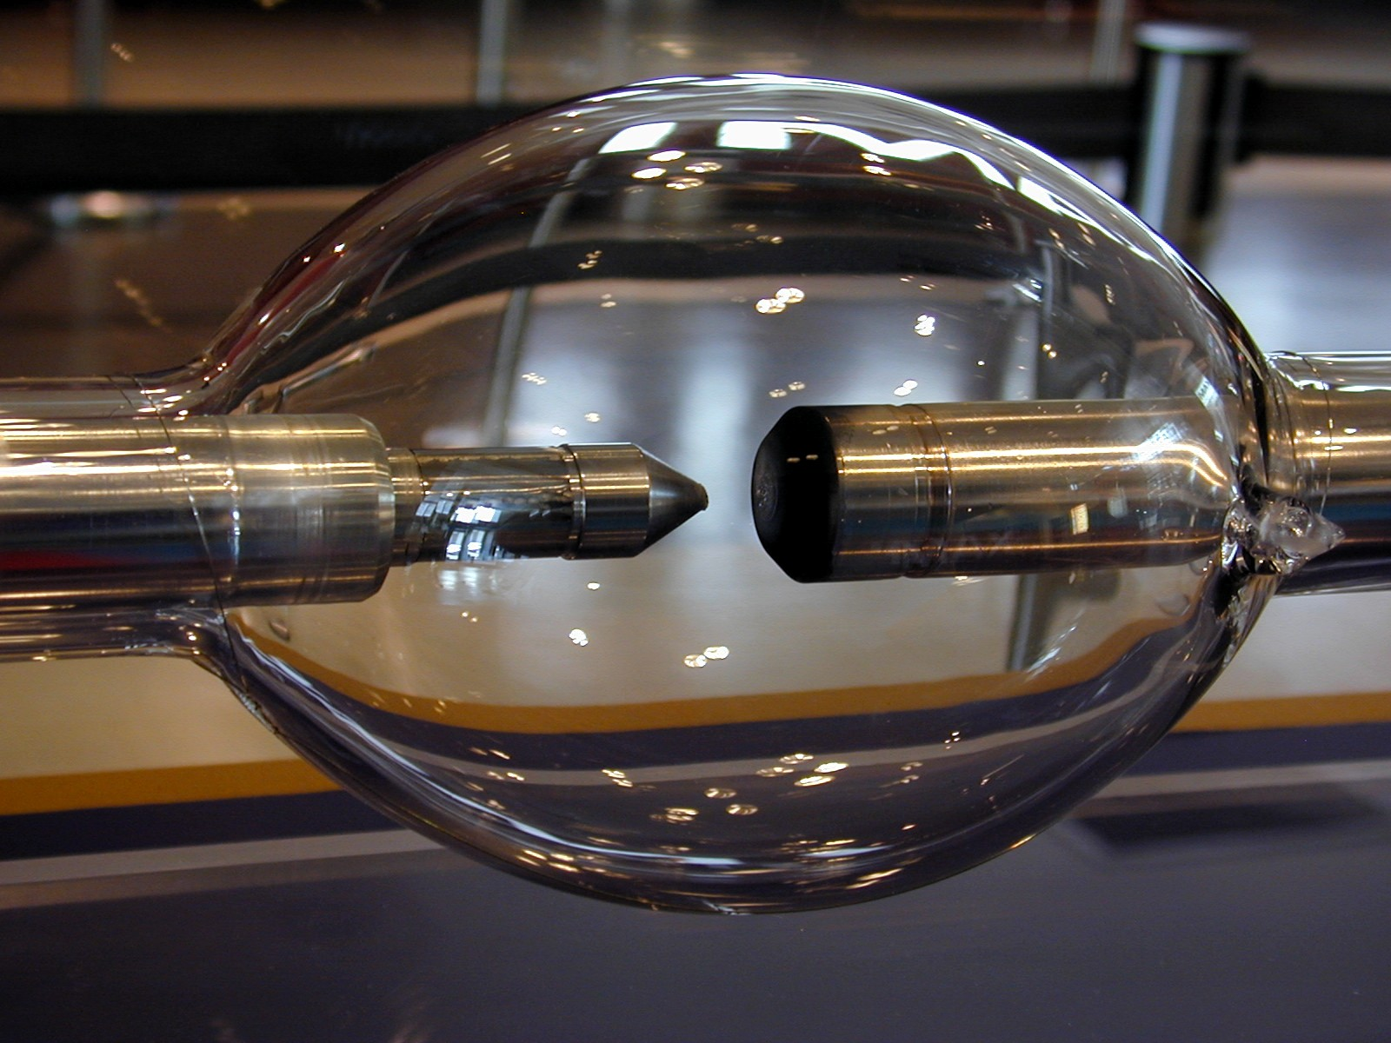
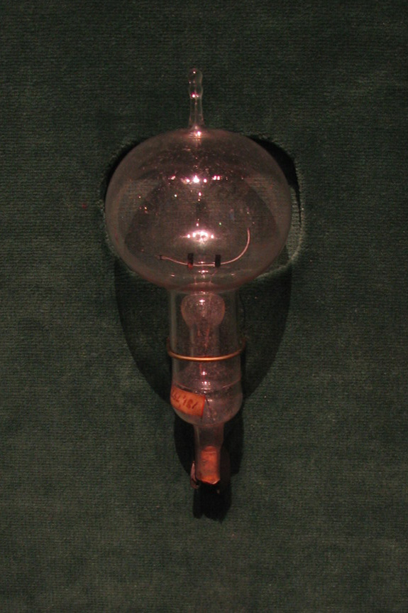
The history of bulbs
Chronology
1854
1876
1932
1959
1962
1983
1990
1995
2010
We are the equivalent of LED for power lighting
Plasma 1st generation 120 lm/W
Fluo Compact 45 to 60 lm/W
Color LED 25 to 300 lm/W
Halogens ~25 lm/W
Filament bulb ~5 lm/W
Arc lamp ~90 lm/W
Fluorescent tube ~100 lm/W
White LED 60 to 75 lm/W
Plasma 2nd generation 90 lm/W

